Slide 1
SafeHer
Kheeleswari Devi Ramanjooloo - 21340941
SammyJoe Macri - 21707659
Staff consulted: Cathal Gurrin

Slide 2

Introduction
SafeHer
Mobile application designed to enhance personal safety for women by providing a comprehensive suite of security features.
Why This Project?
Market Gap
User-Centric Design
Ease of Use
Proactive Measures
Empowerment
Notes:
It empowers users to act swiftly in dangerous situations with discreet, accessible resources while promoting proactive safety measures to help avoid risks. By integrating real-time safety alerts and community-driven tools, SafeHer fosters confidence and control over personal security in both public and private spaces.
Why This Project?
Market Gap: Existing safety solutions often address isolated aspects of safety, lacking a holistic approach.
User-Centric Design: Developed based on personal experiences and feedback from women dissatisfied with current tools.
Ease of Use: Focus on simplicity and reliability, enabling discrete activation in high-pressure situations.
Proactive Measures: Combines real-time alerts with preventive strategies to help users avoid dangerous situations.
Empowerment: Aims to enhance women's confidence and control over their personal safety in everyday life.

Slide 3
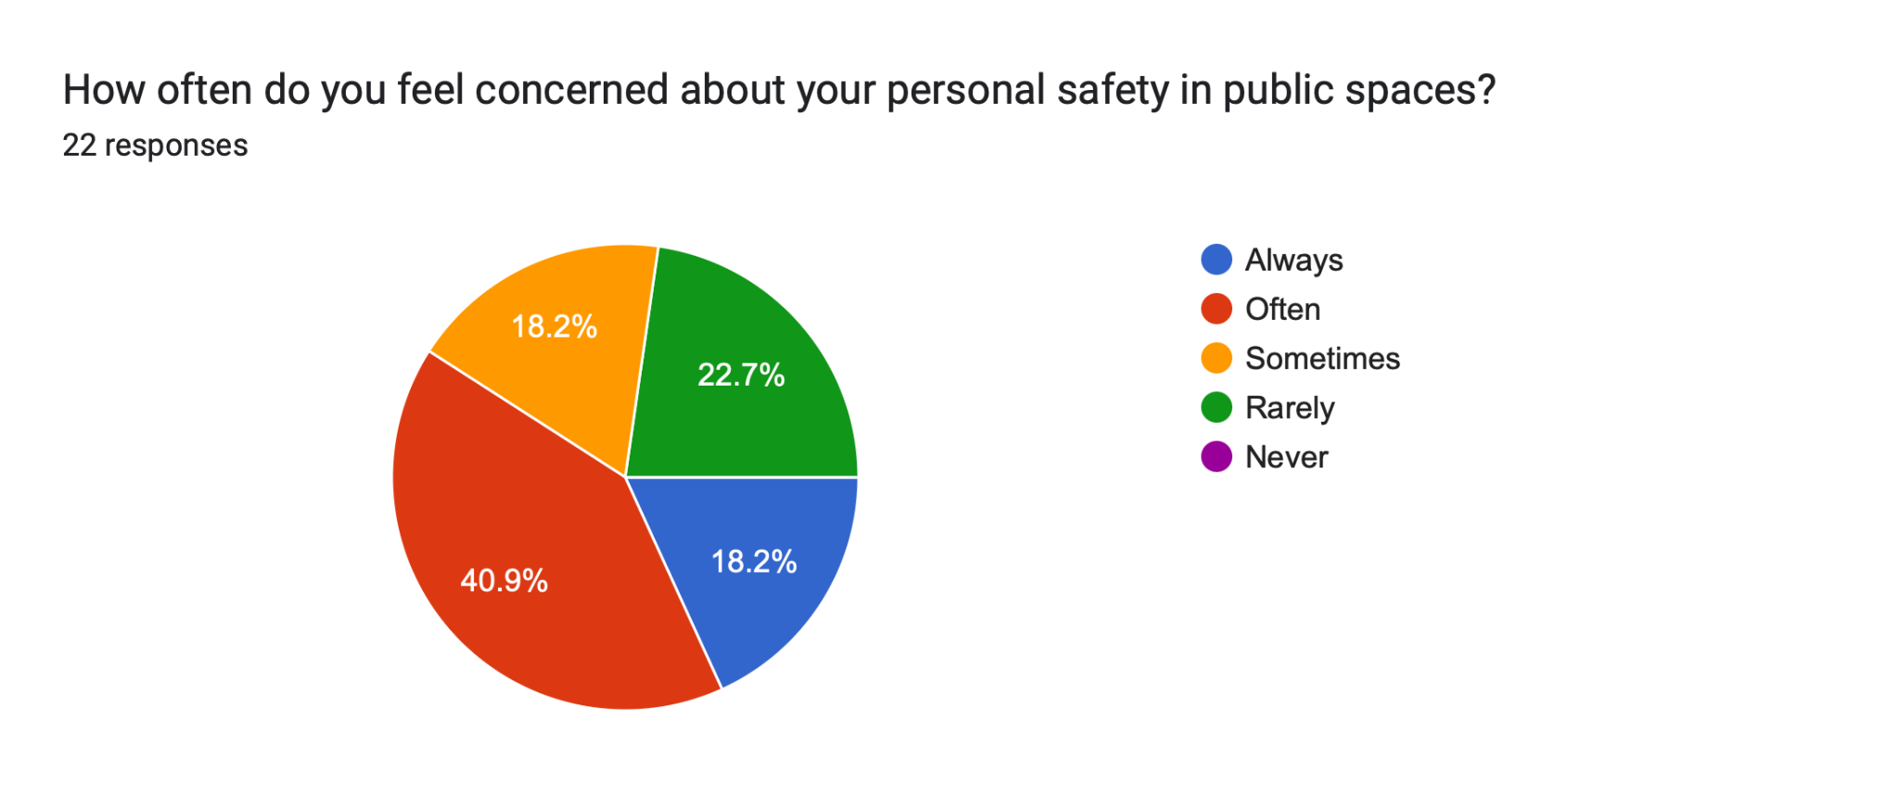
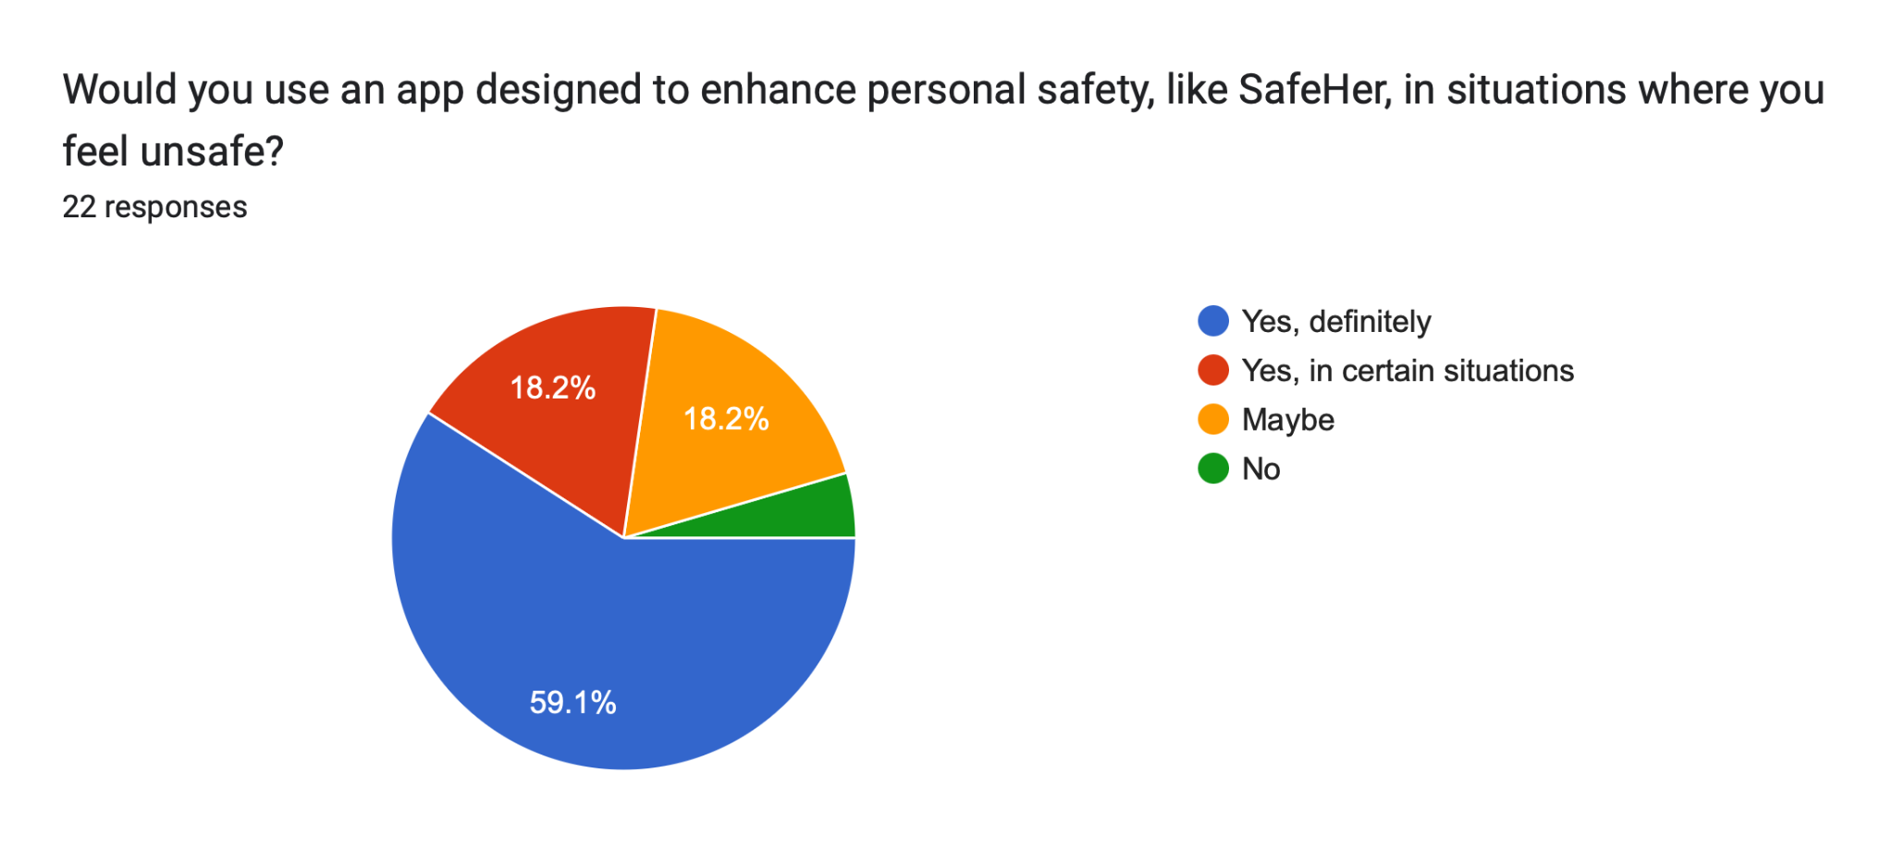
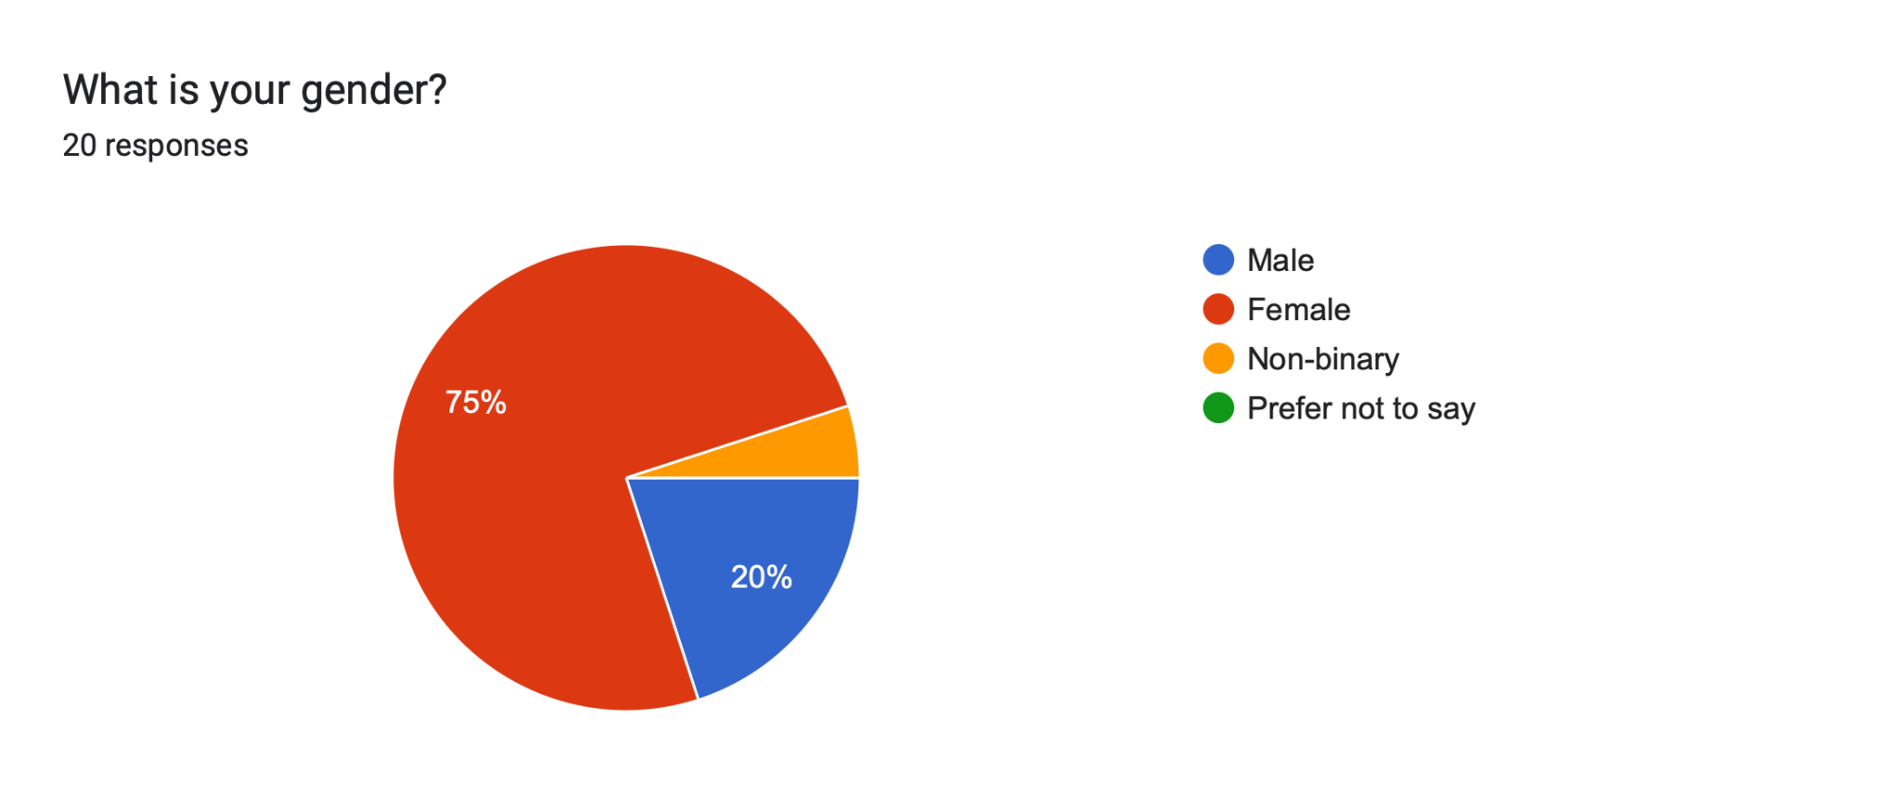
Market Rationale
Target Market Size
Growing Demand
Market Growth
Customer Segments / Users
Women & Students
Fitness Enthusiasts
Main Value Proposition
Comprehensive Solution
Unique Features
Adaptability
Notes:
Target Market Size
Growing Demand: Increasing need for women's safety tools amid rising harassment and assault.
Market Growth: Significant growth in the use of personal safety apps, particularly in urban areas.
Customer Segments / Users
Women & Students: Those commuting or working late.
Fitness Enthusiasts: People going for an early morning run and a night run.
Survivors of Violence: People who have past trauma
Main Value Proposition
Comprehensive Solution: Offers proactive safety measures (safe routes, hazard reporting) alongside emergency response tools (emergency buttons, real-time tracking).
Discretion and Ease of Use: Designed for quick, discreet activation in high-stress situations, addressing key user pain points.
Unique Features: Includes voice-command activation, fake call generator, and automatic audio/video recording.
Adaptability: Customisable safety features appealing to diverse user needs, including parents and guardians.

Slide 4

Primary and Secondary Research
Primary Research
Surveys
Interviews
Secondary Research
Market Reports/News
Competitor Analysis
Feature Comparison
User Feedback
Unique selling point (fake call)
Planned Market Validation
Focus Group debrief
Notes:
Primary Research
Focus Groups: Conduct sessions with women to explore their experiences with current safety apps, identifying gaps and desired features for SafeHer.
Interviews: Engage potential users and safety advocates in one-on-one discussions to gather qualitative insights on their needs.
Secondary Research
Market Reports: Analyze reports on personal safety app growth, user demographics, and trends.
Academic Studies: Review research on women's safety issues and technology adoption for context.
Competitor Analysis
Market Overview: Examine the landscape of personal safety apps and key competitors.
Feature Comparison: Create a chart comparing essential features like emergency alerts and tracking.
User Feedback: Summarize reviews from competing apps to highlight pain points.
Differentiation: Showcase SafeHer's unique features, such as a fake call generator and voice activation.
Planned Market Validation
Focus Group Feedback: Utilize insights from focus groups to inform feature enhancements for SafeHer.

Slide 5

Expected Technical Delivery
Expected Technical Delivery
Initial Platform
Transition to Mobile App
Technical Infrastructure
Mobile App Development
Backend Technologies
Prototype Delivery
Working Prototype: Yes, the initial web-based platform will function as a working prototype
Notes:
Expected Technical Delivery
Initial Platform: A fully functional web-based platform that serves as a prototype, focusing on core functionality, user testing, and refinement.
Transition to Mobile App: Development of a beta-version mobile app after stabilizing the web platform, ensuring a consistent user experience across both platforms.
Technical Infrastructure
Mobile App Development: Utilising React Native for a cross-platform solution (iOS and Android).
Backend Technologies: Employing Node.js and AWS for cloud storage, messaging, and real-time GPS data management.
Prototype Delivery
Working Prototype: Yes, the initial web-based platform will function as a working prototype, allowing for user feedback and iterative improvements before launching the mobile app.

Slide 6
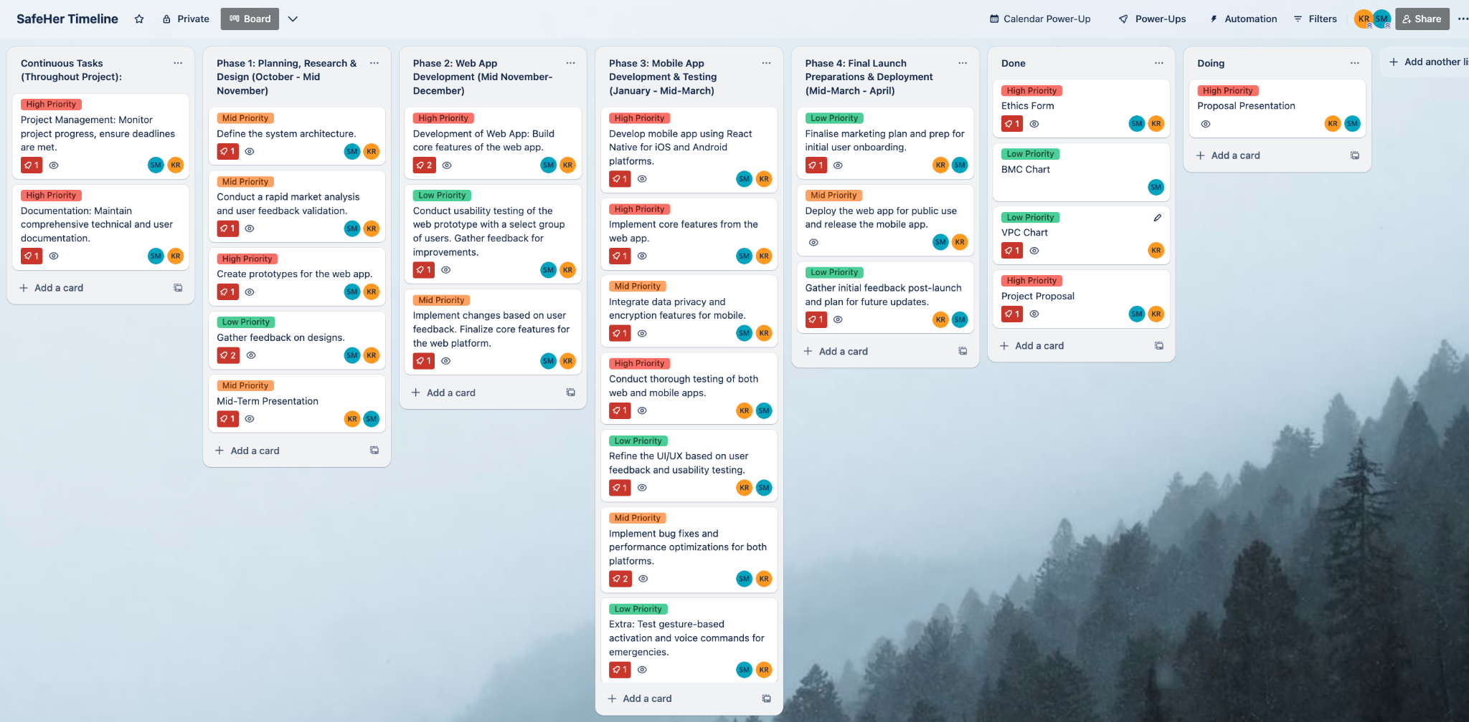
Proposed Timeline of Activities

Slide 7

Thank You for Your Attention!

